Slide 1


Where can studying Food and Nutrition take you?
Highlighting the relevance of Food and Nutrition to future careers and opportunities

Slide 2

What pathways can you take with this subject?
What do you think these roles involve (daily task, etc.)?
Why Food and
Nutrition matters
What careers can you think of that use Food and Nutrition?
Have you ever considered where studying Food and Nutrition can take you?
Today, we’ll be exploring some of
the career opportunities that are available to you, as well as the various pathways you can take to get there.
Why is Art & Design an important subject?
Why Food science matters|Institute of Food Technology
What skills do you think you might need for these roles?

Slide 3




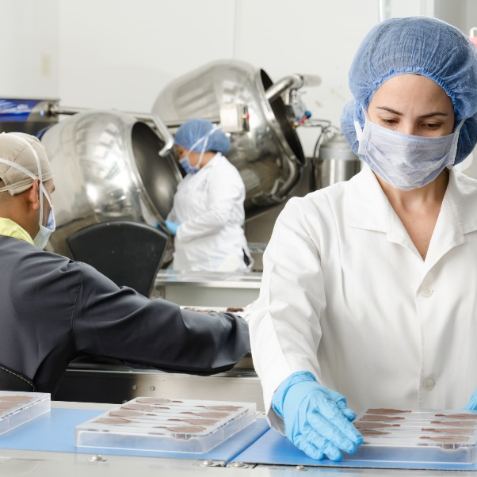
Chef
BBC Bitesize case study
BBC Bitesize case study
Explore a career as a…
icould case study
Here are some example roles and careers linked to
Food and Nutrition
Food Technologist
icould case study
STEM case study
Food Quality Control Inspector
BBC Bitesize Profile

Slide 4



Dietician
Explore a career as a…
icould case study
icould case study
Restaurant Manager
Here are some example roles and careers linked to
Food and Nutrition
BBC Bitesize Profile
icould case study
Food & Beverage Manager
icould case study
YEUK case study
Careers First case study

Slide 5
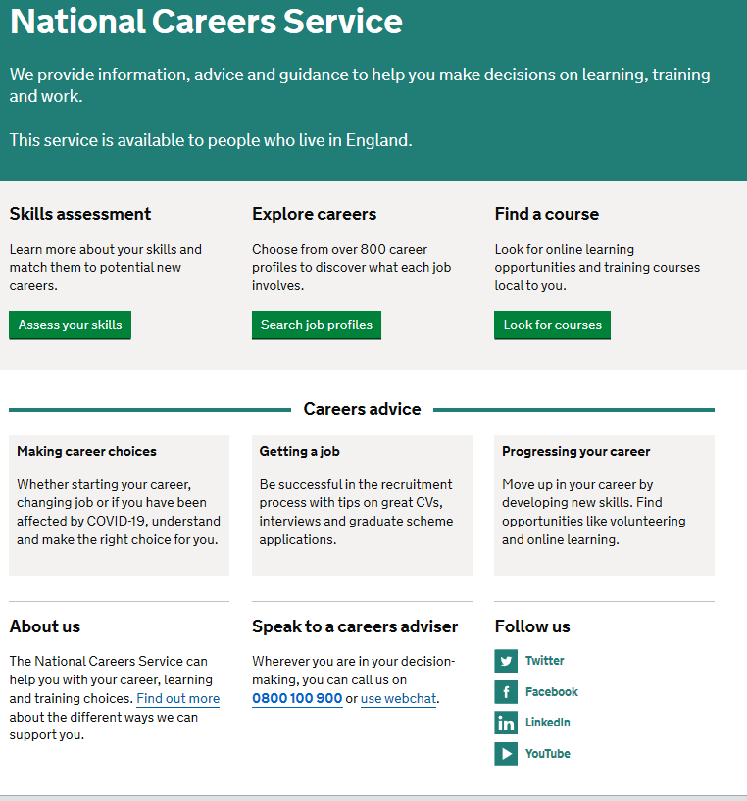
Discover more about the role
Explore careers using National Careers Service and find out about what jobs involve and how they are right for you
Includes:
Average salary
Typical hours
Work patterns
Pathways/How to become
Essential Skills
Daily tasks
Career path and progression
Current opportunities
Research Ideas:
Chef
Food Technologist/Scientist
Food Quality Control Inspector
Dietician
Restaurant Manager
Catering Manager

Slide 6


GCSE
While there are different routes you can take to be a teacher there are a few essential things that you will need:
• A minimum GCSE Grade 4 or above in English and maths (plus science if you want to teach primary)
A degree or equivalent qualification
A level
T Level
Vocational/Technical Qualification
Apprenticeship
A levels are 2 years of study
T Levels are nationally recognised, technical qualifications for 16–19-year-olds. Designed by leading employers, one T Level is equivalent in size to 3 A levels
These include BTEC, Applied General Qualifications (AGQ) and Vocational Technical Qualifications (VTQ) – all at Level 3
Apprenticeships are jobs which combine practical work and study. Intermediate is Level 2, Advanced is Level 3
Degree
Level 4/5 qualifications
Higher apprenticeships
Complete a degree course
It is possible to get QTS as part of an undergraduate degree, for example:
• Bachelor of Arts (BA) with QTS
• Bachelor of Education (BEd) with QTS
• Bachelor of Science (BSc) with QTS
Complete a L4/5 course and top up to a degree – L4/5 includes Certificate of HE, Diploma of HE, Higher Technical Qualification (HTQ), HNC, HND and Foundation degrees
Top up to a degree (Level 6) in a year of full-time study
Higher level apprenticeship (foundation degree / Level 5)
Degree apprenticeships
Degree apprenticeship
(Level 6-7). There is a Level 6 Teaching apprenticeship programme
Initial Teacher Training (ITT) with qualified teacher status (QTS)
Teacher

Slide 7


